Slide 1
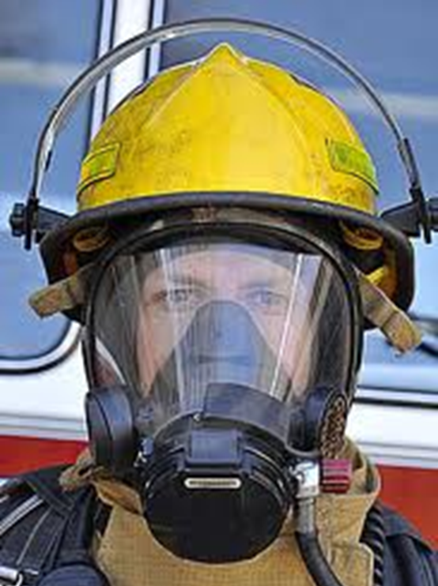
The Fireman
and his Equipment
Dear Parents,
Fire Safety is a week long theme for Little Lancers every fall. During this unit of study Little Lancers learn to keep themselves safe and never to play with matches. We practice home telephone numbers as well as the cell phone number of the children's parents. We a lot work on remembering mommy and daddy’s given name.
Our preschoolers and teacher watches a video entitled “Stop Drop and Roll”. Our local fire company comes and visits the preschool to familiarize the children with the clothing a fireman wears to protect himself during the unfortunate event of a house fire. This concept book helps to familiar our preschooler with the vocabulary of the unit.
By Mrs. Lane / Fire Safety

Slide 2
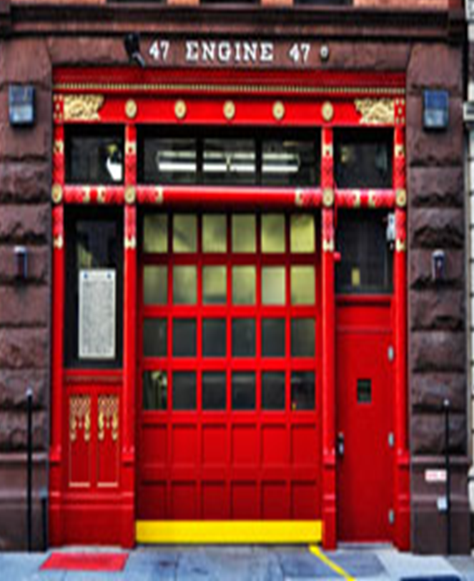
Firemen Fireman are our friends. They save people from car accidents and from fires. They wear protective clothing to keep their bodies safe. Fireman have special trucks and boats. Firemen spend their time at the firehouse where they man have a special friend a fire dog.
fire station

Slide 3
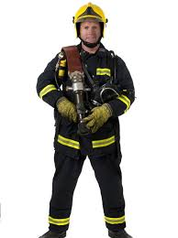
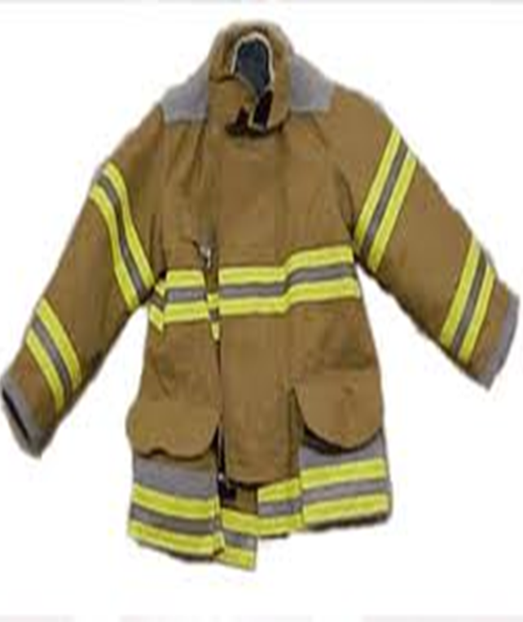
fireman
fire jacket

Slide 4
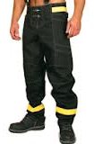
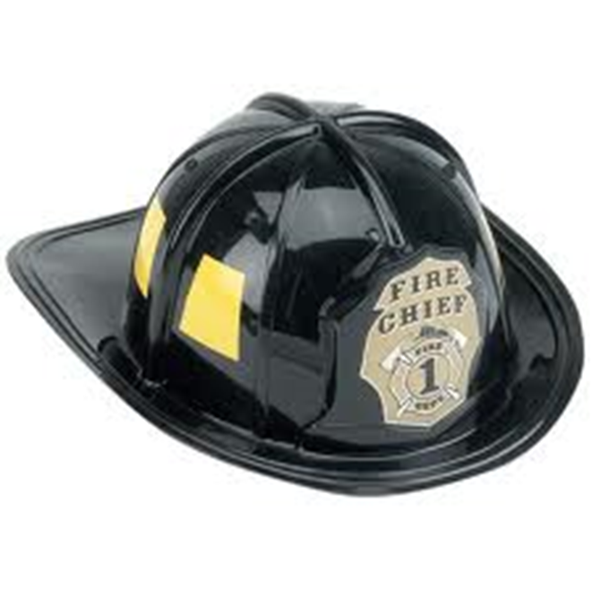
fire pants

Slide 5
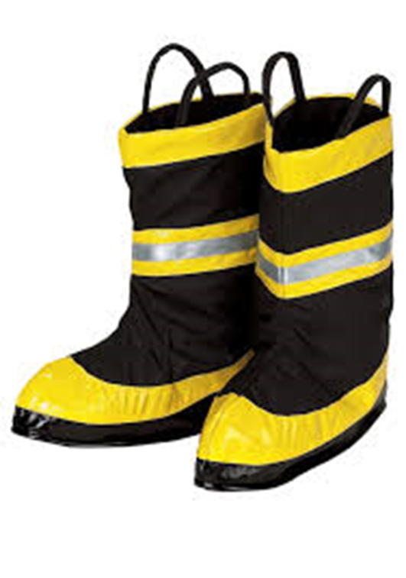
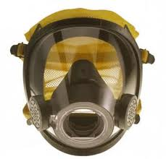
fire boots
fire mask

Slide 6
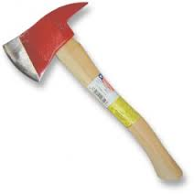
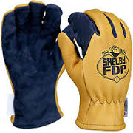
fire gloves
fire ax

Slide 7
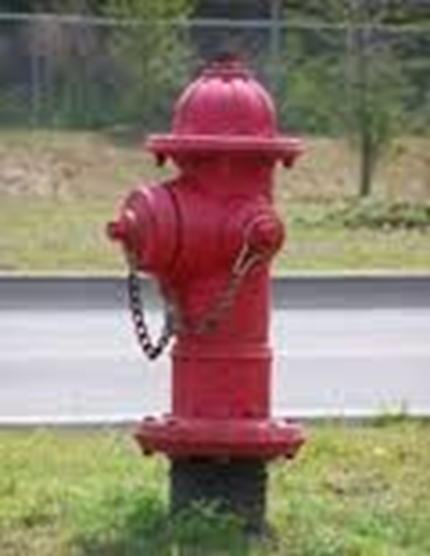
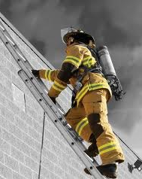
fire hydrant
fire ladder

Slide 8
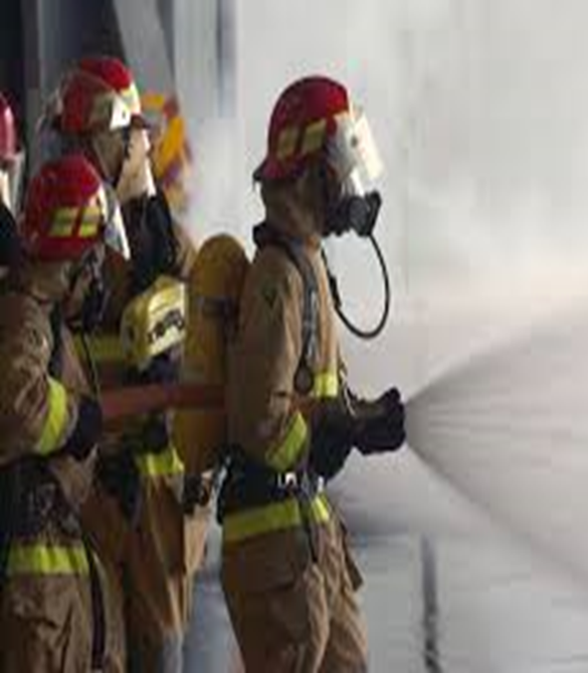
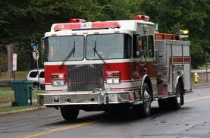
fire hose
fire truck

Slide 9
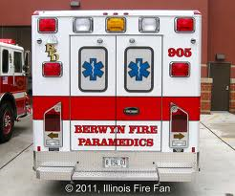
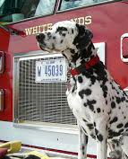
ambulance
fire dog

Slide 10
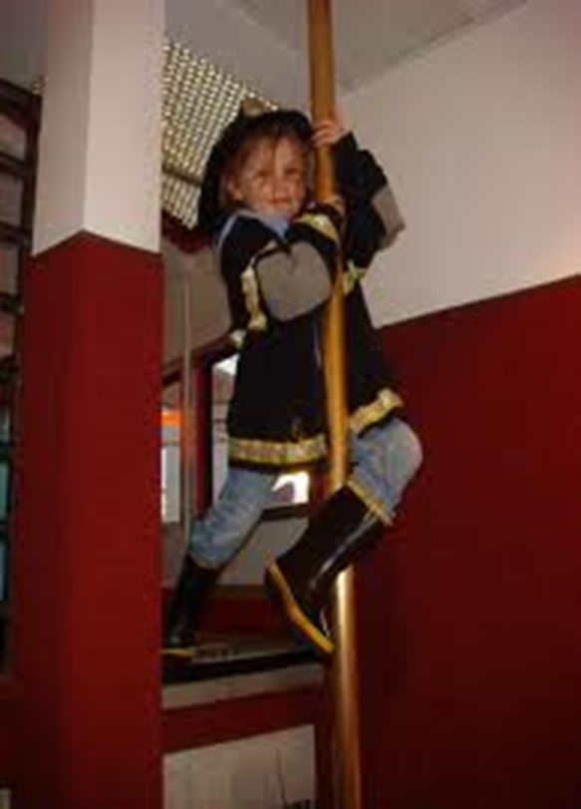
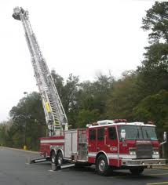
fire pole
ladder truck

Slide 11
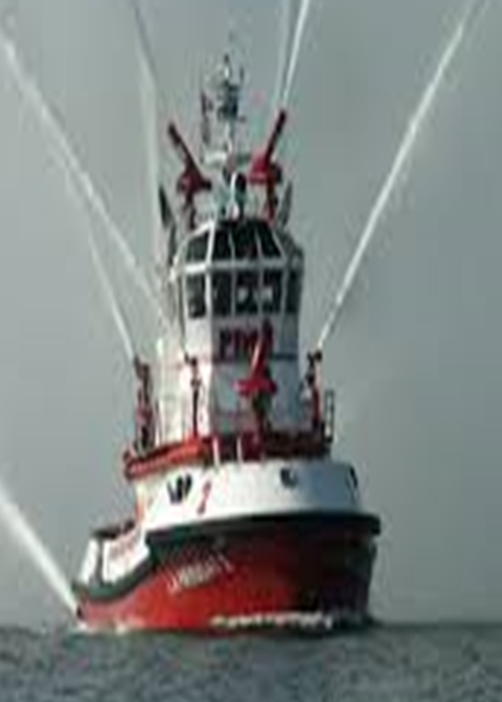
fire boat
Firemen are our friends.

