Slide 1
Title Slide for Prop Box
Virtual Prop Box
Your name
Child Development I
LHS 2012

Slide 2
Center Your Box will be Used In
Traditional Use – add photo
Creative Use – add photo

Slide 3
The box
How will you decorate your box?
Explain what type of box you will use to collect your artifacts, books and props.
Add photos

Slide 4
The PROPS

Slide 5
The PROPS

Slide 6
The PROPS

Slide 7
The PROPS

Slide 8
The PROPS

Slide 9
The PROPS

Slide 10
Environmental Print

Slide 11
Functional Print

Slide 12
Authentic Writing Experiences
Show at least two examples of authentic writing the children can use to

Slide 13
Social Skills Developing Cooperation

Slide 14
Traditional Roles
Boys
Girls

Slide 15
How will you help teach across these gender biases?

Slide 16
What Multi– Cultural lessons can be taught with your props?
Add pictures and description here.

Slide 17
Theme Specific Vocabulary
Vocabulary
Vocabulary
Vocabulary
Vocabulary

Slide 18
Theme Specific Dialog
He said “ ….”
She said “ ….”
She said “ ….”
He said “ ….”

Slide 19
Six Open Ended Questions To Engage

Slide 20
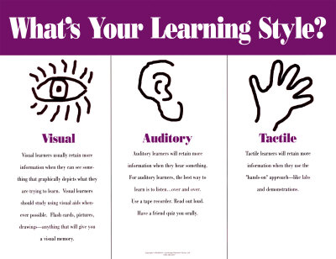

Slide 21
Visual Learners will be able to observe knowledge through
What visual photos or diagrams can you add to your prop box to help the children learn.
Examples Diagrams:
Veggie and Fruits
Vehicles that move with 2 wheels / 4 wheels.
Eye Chart in Doctors office, letter and numbers

Slide 22
Auditory Learners will be able to listen to
What can be said or listened to build vocabulary and comprehensions skills.
Music, book on tape, oral directions.

Slide 23
Tactile Learners will enjoy
Think about the different textures that could be felt that pertain to your prop box.
List them and descriptive words that would add to the preschool child's vocabulary.

Slide 24
Delete this slide before you turn in or present your assignments informative only for slides 19 – 20.
Use your “pink Handout” that explains developmentally appropriate skills that can be taught with your prop box.

Slide 25
Concepts to be Taught
Social
Emotional – Self concept

Slide 26
Concepts to be Taught
Comprehension
Pre Reading -

Slide 27
Conceptual Learning continues…
Expressive language
Math

Slide 28
Conceptual Learning continues…
Gross motor
Fine motor

Slide 29
This prop box will appeal to children because

Slide 30
Safety & Durabilty
Safety steps taken
Durability considerations

Slide 31
Book ONE
Title
Author

Slide 32
Book TWO
Title
Author

Slide 33
Sneak Preview to the Two Lessons
Lesson One
Lesson Two

Slide 34
Resources used for design of this Prop Box

